Slide 1

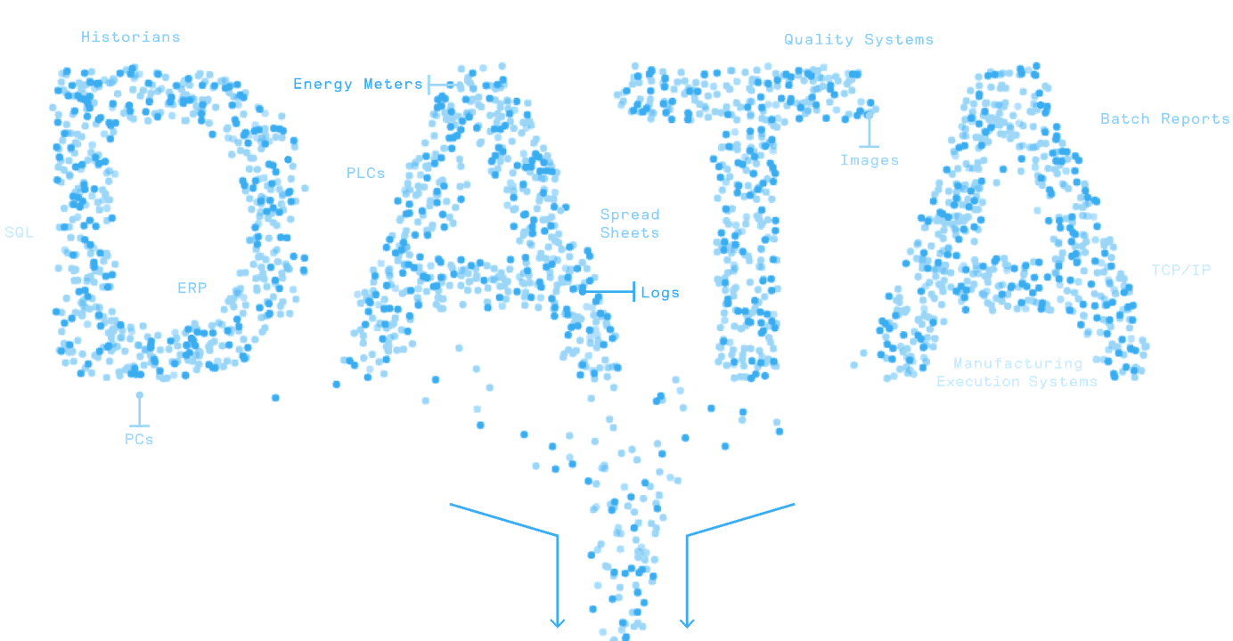


MATLAB Fundamental Laboratory Handbook (MATLAB)
Chapter 14 Resources and Online Courses
Dr Leo Chen
leo.chen@ieee.org
1

Slide 2
12. 1 Lab
Objective: Get familiar with Official MATLAB Resources
Content：
Go to www.mathworks.com
Go to the support interface, open online MATLAB documents, and get familiar with the resources here;
Try using online MATLAB documents to search for examples that you are interested in, such as deep learning, data analysis, etc.

Slide 3
12. 2 Lab
Objective: Get familiar with MATLAB Community
Content：
Go to www.mathworks.com
Go to the "Community" interface and get familiar with the resources on it;
Go to "File Exchange" to find the File of interest;
Go to "Cody" and try to solve a problem.

Slide 4
12. 3 Lab
Objective: Get familiar with Code Repositories
Content：
Try to save MATLAB code to MATLAB Drive
Try to open the code that already exists in MATLAB Drive

